Slide 1
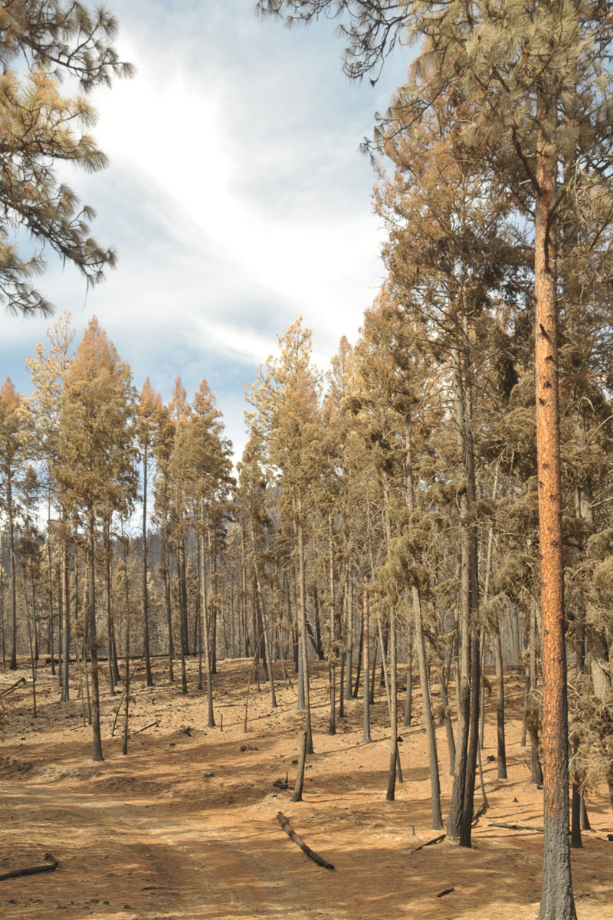
Fire and Forest health
Agents, impacts and mitigation

Slide 2
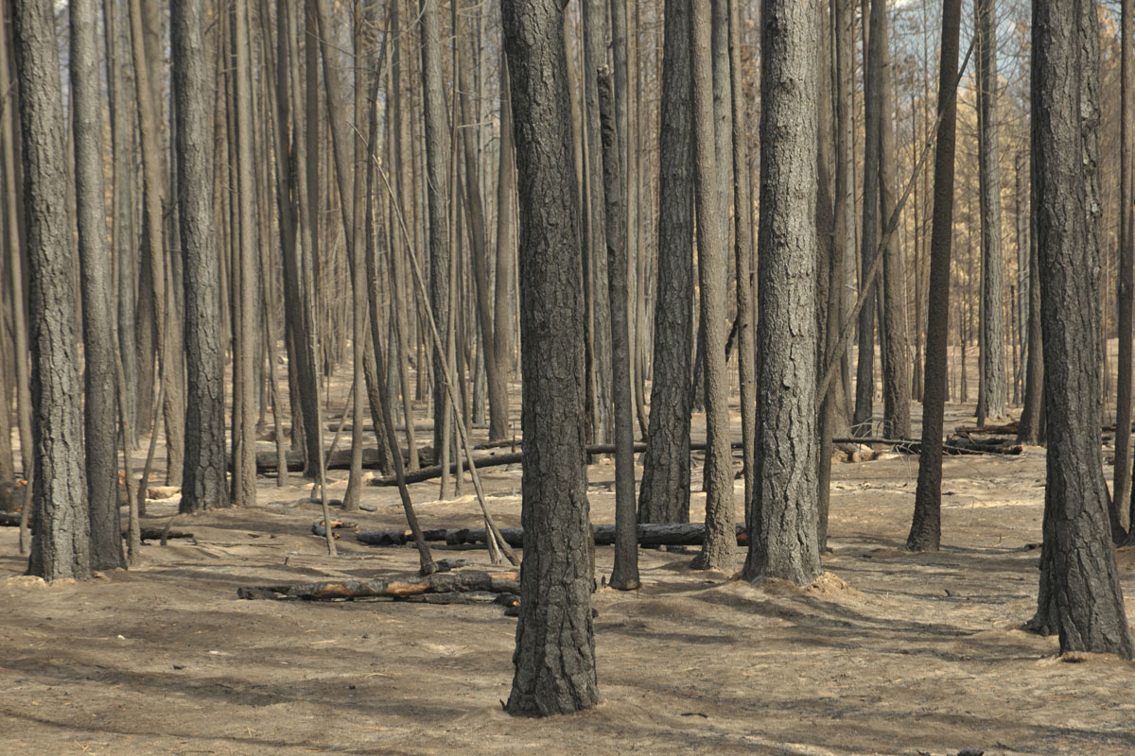
Objectives - Discussion
How to approach and assess fire damage and potential forest health impacts in recently burned areas.
Review management options to minimise plantation damage and bark beetle impacts in high value stands.
Whose responsibility,
who does the work
(Licensees, FFT, FH,
Consultants)?
Budget estimates for FH.

Slide 3
N60584 | West of Rock Creek | Aug 13, 2015 | 4,534.00
N60585 | Granby/Lynch Creek | Aug 13, 2015 | 1,966.00
N10741 | Cherry Lake | Aug 25, 2015 | 1,250.00
N50600 | Deer Creek Main | Aug 14, 2015 | 1,240.00
N70261 | Sitkum Creek | Jul 4, 2015 | 777
N70624 | Mt. Midgeley | Aug 14, 2015 | 480
N70245 | Poplar Creek | Jul 2, 2015 | 470
N60590 | Paulson | Aug 13, 2015 | 320
N60667 | Blue Joint | Aug 16, 2015 | 303
N60726 | Mount Faith | Aug 21, 2015 | 270
N10278 | Redding Creek | Jul 5, 2015 | 250
N50577 | Big Sheep Creek | Aug 12, 2015 | 227
N40126 | Bush River FSR 87km | Jun 13, 2015 | 209
N10262 | White Creek | Jul 4, 2015 | 207
N10307 | Redding Creek | Jul 8, 2015 | 200
N10279 | West Fork St. Mary | Jul 5, 2015 | 189
N70616 | Mt Dickson | Aug 14, 2015 | 165
N50255 | Fullmer Creek | Jul 4, 2015 | 145
N10269 | Baynes Lake | Jul 4, 2015 | 117
N20484 | Spillimacheen River | Jul 21, 2015 | 115
N10482 | Ward Creek | Jul 21, 2015 | 110

Slide 4
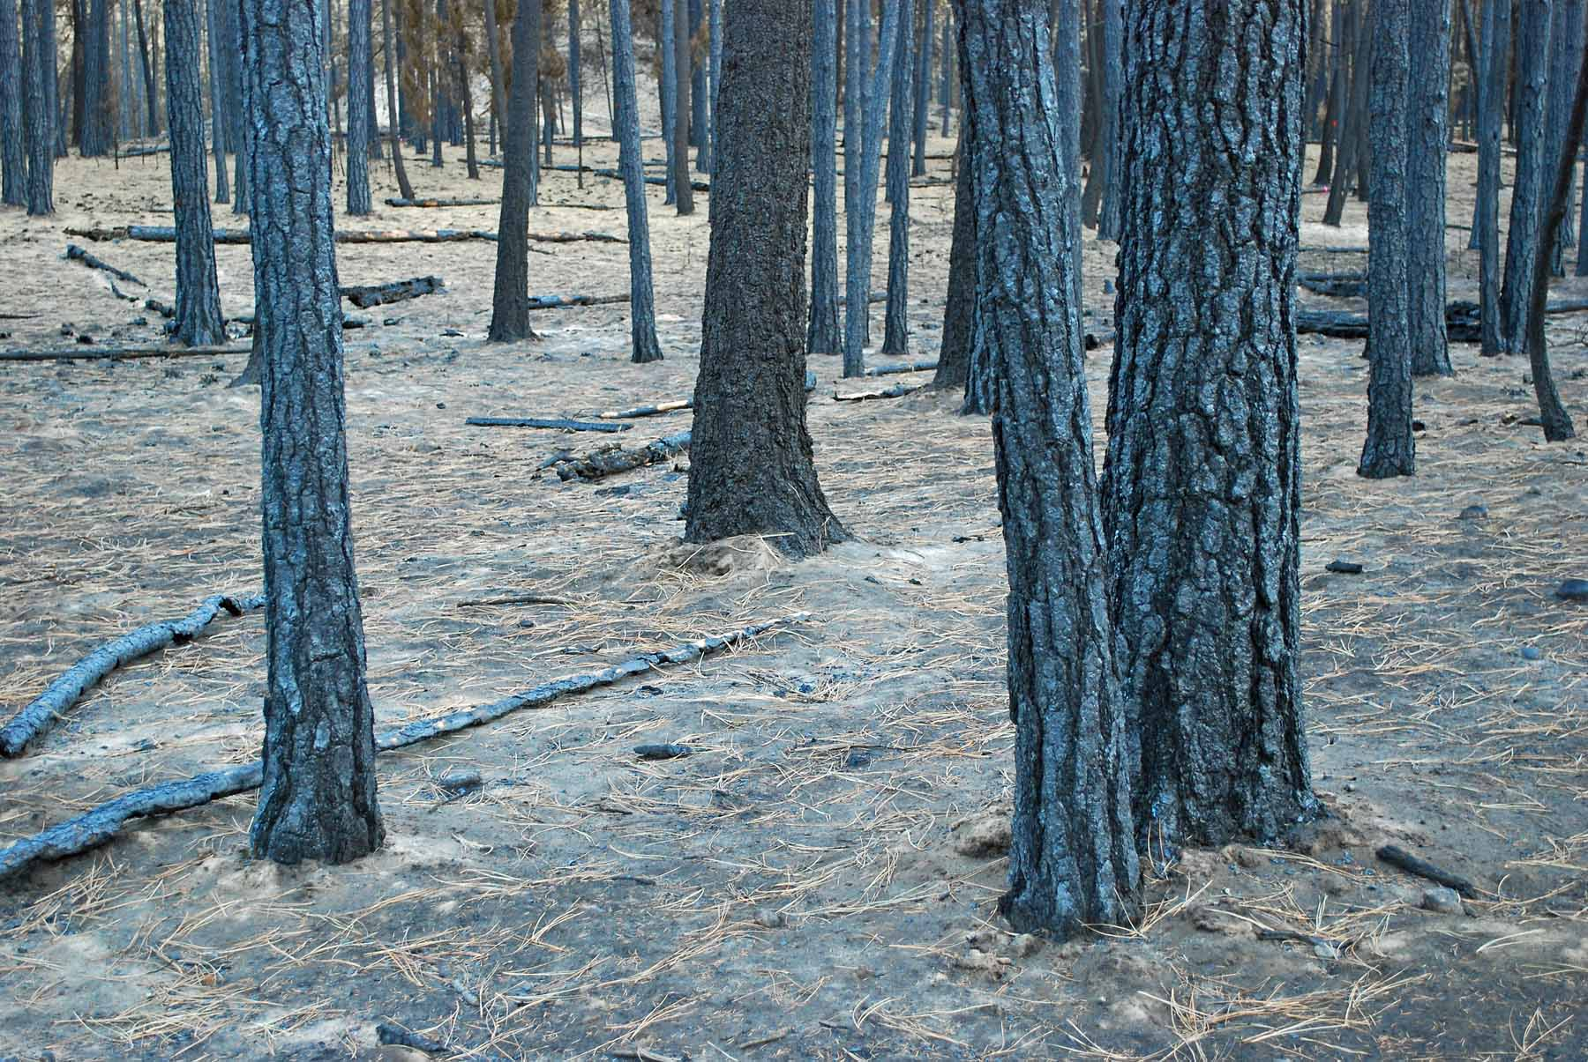
What are the factors determining impact?
Tree size, age, vigour
Fire season
Severity:
  Foliage consumption, crown scorch, bud kill
  Bole scorch height,
  circumference
  and depth
  Ground layer
  consumption (LFH)
Beetle pressure
Drought?

Slide 5
What can show up after a fire?
Seedling mortality
  Rhizina
  Black army cutworm (Actebia fennica)
In Douglas-fir
  Douglas-fir beetle
In Ponderosa pine
  Western pine beetle
  Red turpentine beetle
  (Mountain pine beetle? IBM generally doesn’t like fire damaged trees)

Slide 6
What can show up after a fire?
Higher elevations
  Spruce beetle, western balsam bark beetle
  Thin barked trees are highly suceptible to fire damage.
General damage agents
  Secondary insects, woodborers and ambrosia beetles

Slide 7
Possible impacts
Trees are killed outright by crown fires and high intensity fires.
Lower intensity fires cause stress or partial tree kill, and trees continue to die for up to 4 years, especially Fd and Py.
Bark beetle populations may build and kill healthy trees in unburned adjacent areas.
Rhizina root disease and black army cutworm can cause mortality of seedlings planted in newly burned areas.

Slide 8
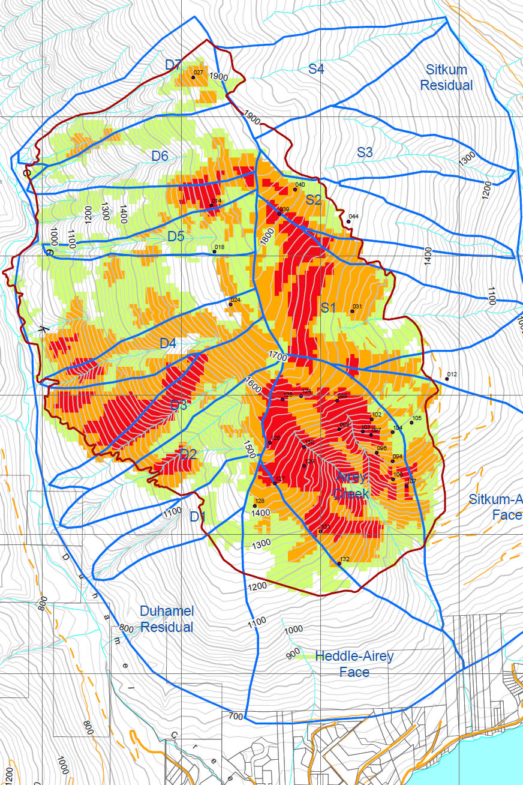
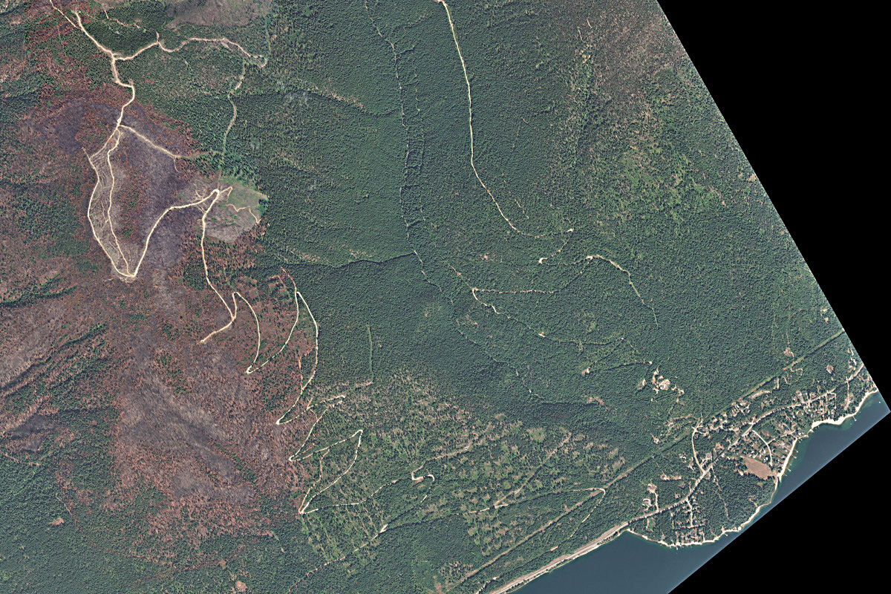
Will Burt, Assessing Fire Severity

Slide 9
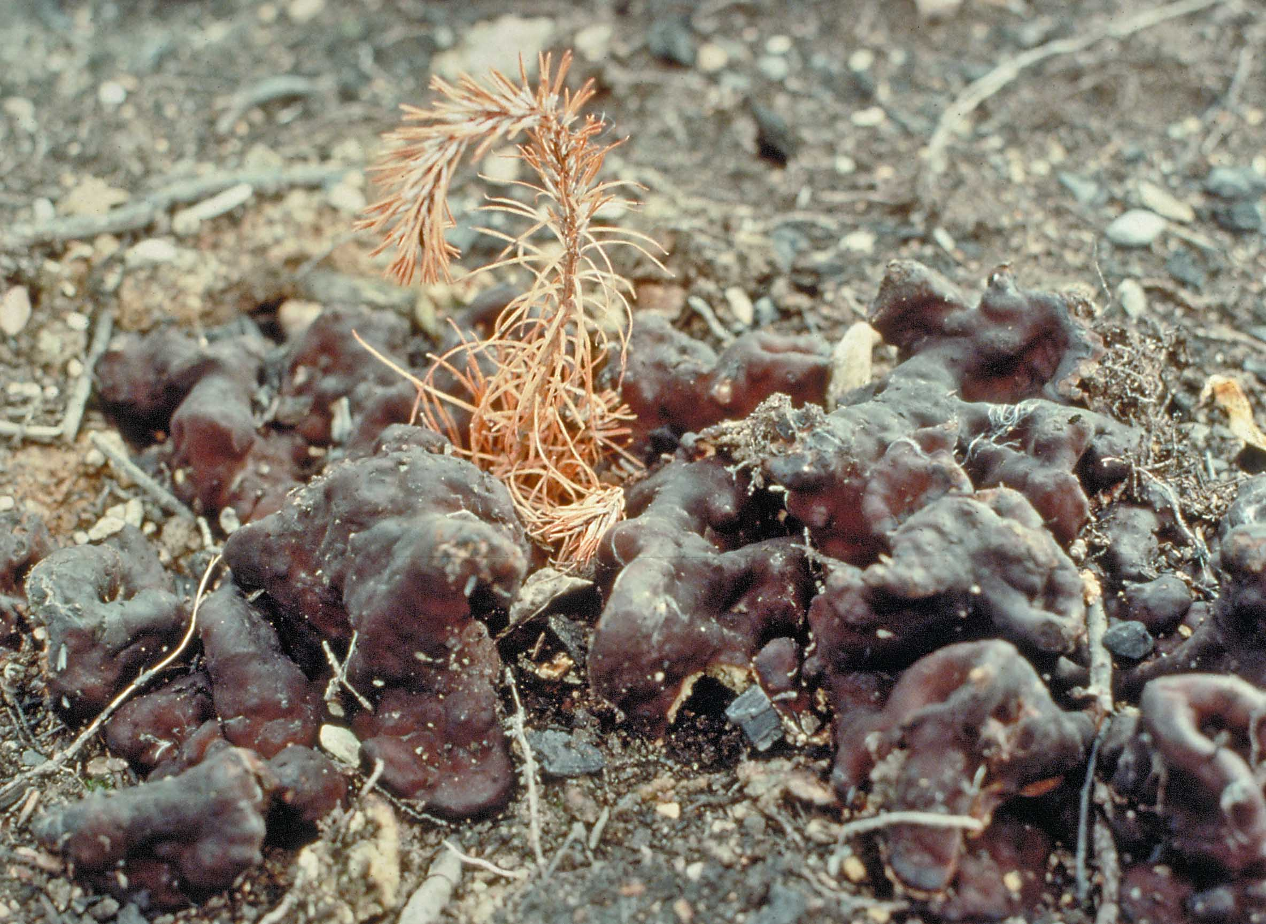
Rhizina root disease – Michael Murray

Slide 10
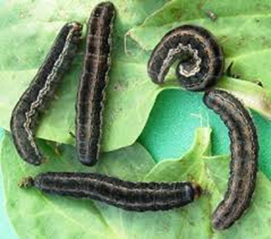
Black Army Cutworm
Not new, BAC was a major pest in the 1980s associated with broadcast burning
Moving away from prescribed burn site prep has decreased occurrence of this pest
Trapping protocols in place
Costs: trap maintenance, lures, vapona, moth counts.

Slide 11
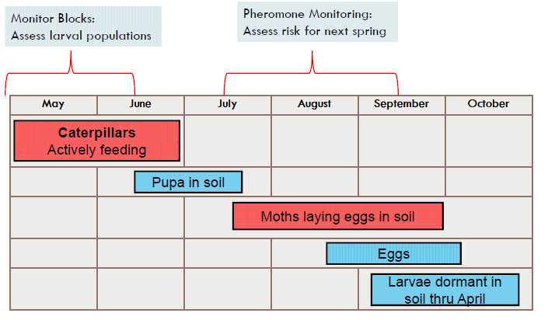
Black army cutworm - opportunities to assess risk

Slide 12
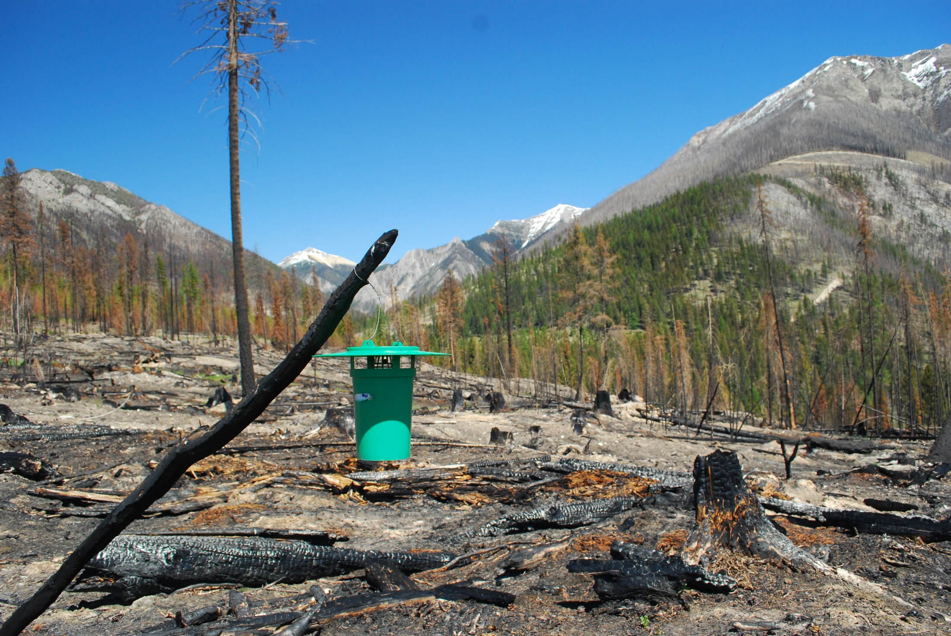
Severe fire with no residual vegetation
= high risk for black army cutworm. Mt Glen fire 2015

Slide 13
Douglas-fir beetle Management Summary
Sanitation harvest
Trap trees
  Most effective in reducing DFB population
  Least cost?
  Fall Douglas-fir in spring & harvest them in fall / winter
Funnel traps
  Time commitment to maintain during the summer
  Use to reduce DFB populations
Repellents - MCH
  Seed trees, UWR, trees near funnel traps, felled trees
  Minimal cost
  Reduced risk of losing high value Douglas-fir

Slide 14
Pine beetles Management Summary
Sanitation harvest (IBW, IBM)
Funnel traps
  Time commitment to maintain during the summer
  Use to reduce IBW populations
Repellents
  Verbenone, IBM only
  Seed trees
  Minimal cost
  Reduced risk of losing high value Py

Slide 15
Risk of damage X fire severity (?)
 | Fire Severity
 | Low | Moderate | Severe | Very severe
Rhizina | L | H | L | L
BAC | L | L | H | H
Bark beetles | L | H | M | L
Wood borers | L | H | H | L

Slide 16
Proposed approach
Identify areas by burn severity classes (some ground checks).
Identify areas requiring BAC cutworm traps.
Identify possible Rhizina risk areas

Slide 18
Proposed approach
For bark beetles
  Overlay IBD/IBS hazard rating over fire area.
  Overlay VRI > 40 Py volume.
  Assess felled material in fuel free zones.
  Eliminate areas in completely burned and unburned areas, determine suitable survey areas.
  Assess existing known beetle pressure.
  Classify areas as possible L, M, H Fd and Py hazard areas.
  Decide where to survey

Slide 19
Proposed approach
For bark beetles (continued)
  Grid survey 5m width
  Prism plot per 5 ha:
    crown scorch, bark char (intensity, height, and circumference), spp X dbh .
  Classify areas as L, LM, M, H IBD current infestation levels

Slide 20
Proposed approach
For bark beetles (continued)
Establish sanitation harvest, anti-aggregation, and funnel trap treatment areas in priority moderate/light damage areas.
(Establish 4-5 yr PSPs in moderate/light damage areas to follow tree fates?)
Salvage harvest in severe damage areas.

Slide 21
What else?
Whose responsibility, who does the work?
(Licensees, FFT, FH, Consultants)?
Budget items:
  MCH
  Verbenone
  Funnel traps, IBD/IBW lures,vapona
  Survey contracts
What’s next?

Slide 22
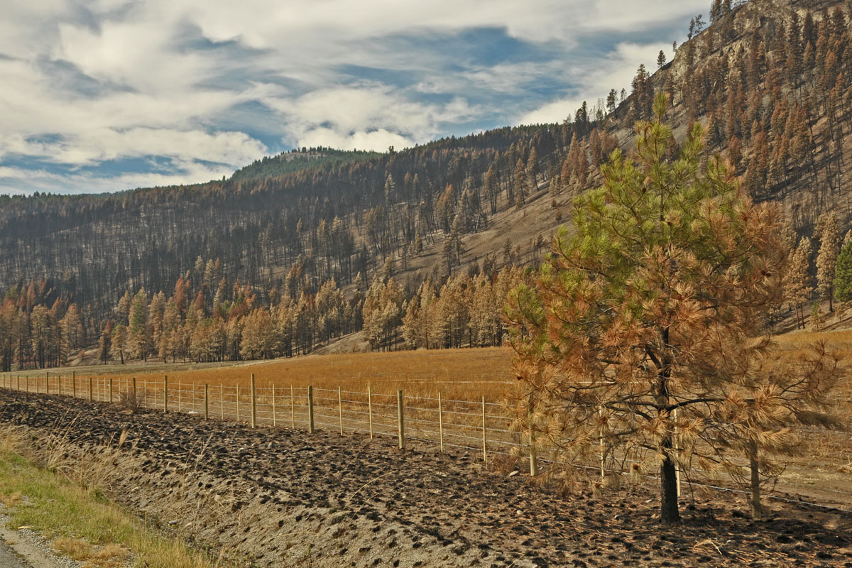
Thanks!

Slide 23
Art Stock
Forest Entomologist
MFLNRO, Kootenay-Boundary Region
250-354-6911
art.stock@gov.bc.ca

Slide 24
?s

Slide 25
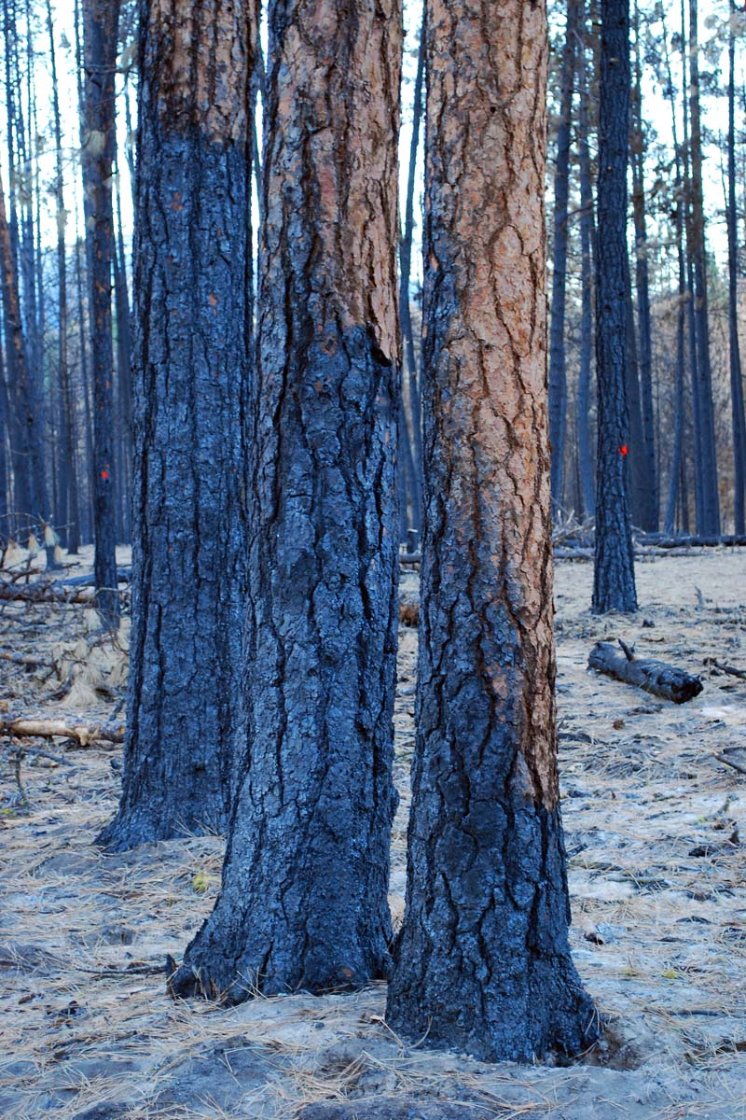

Slide 26
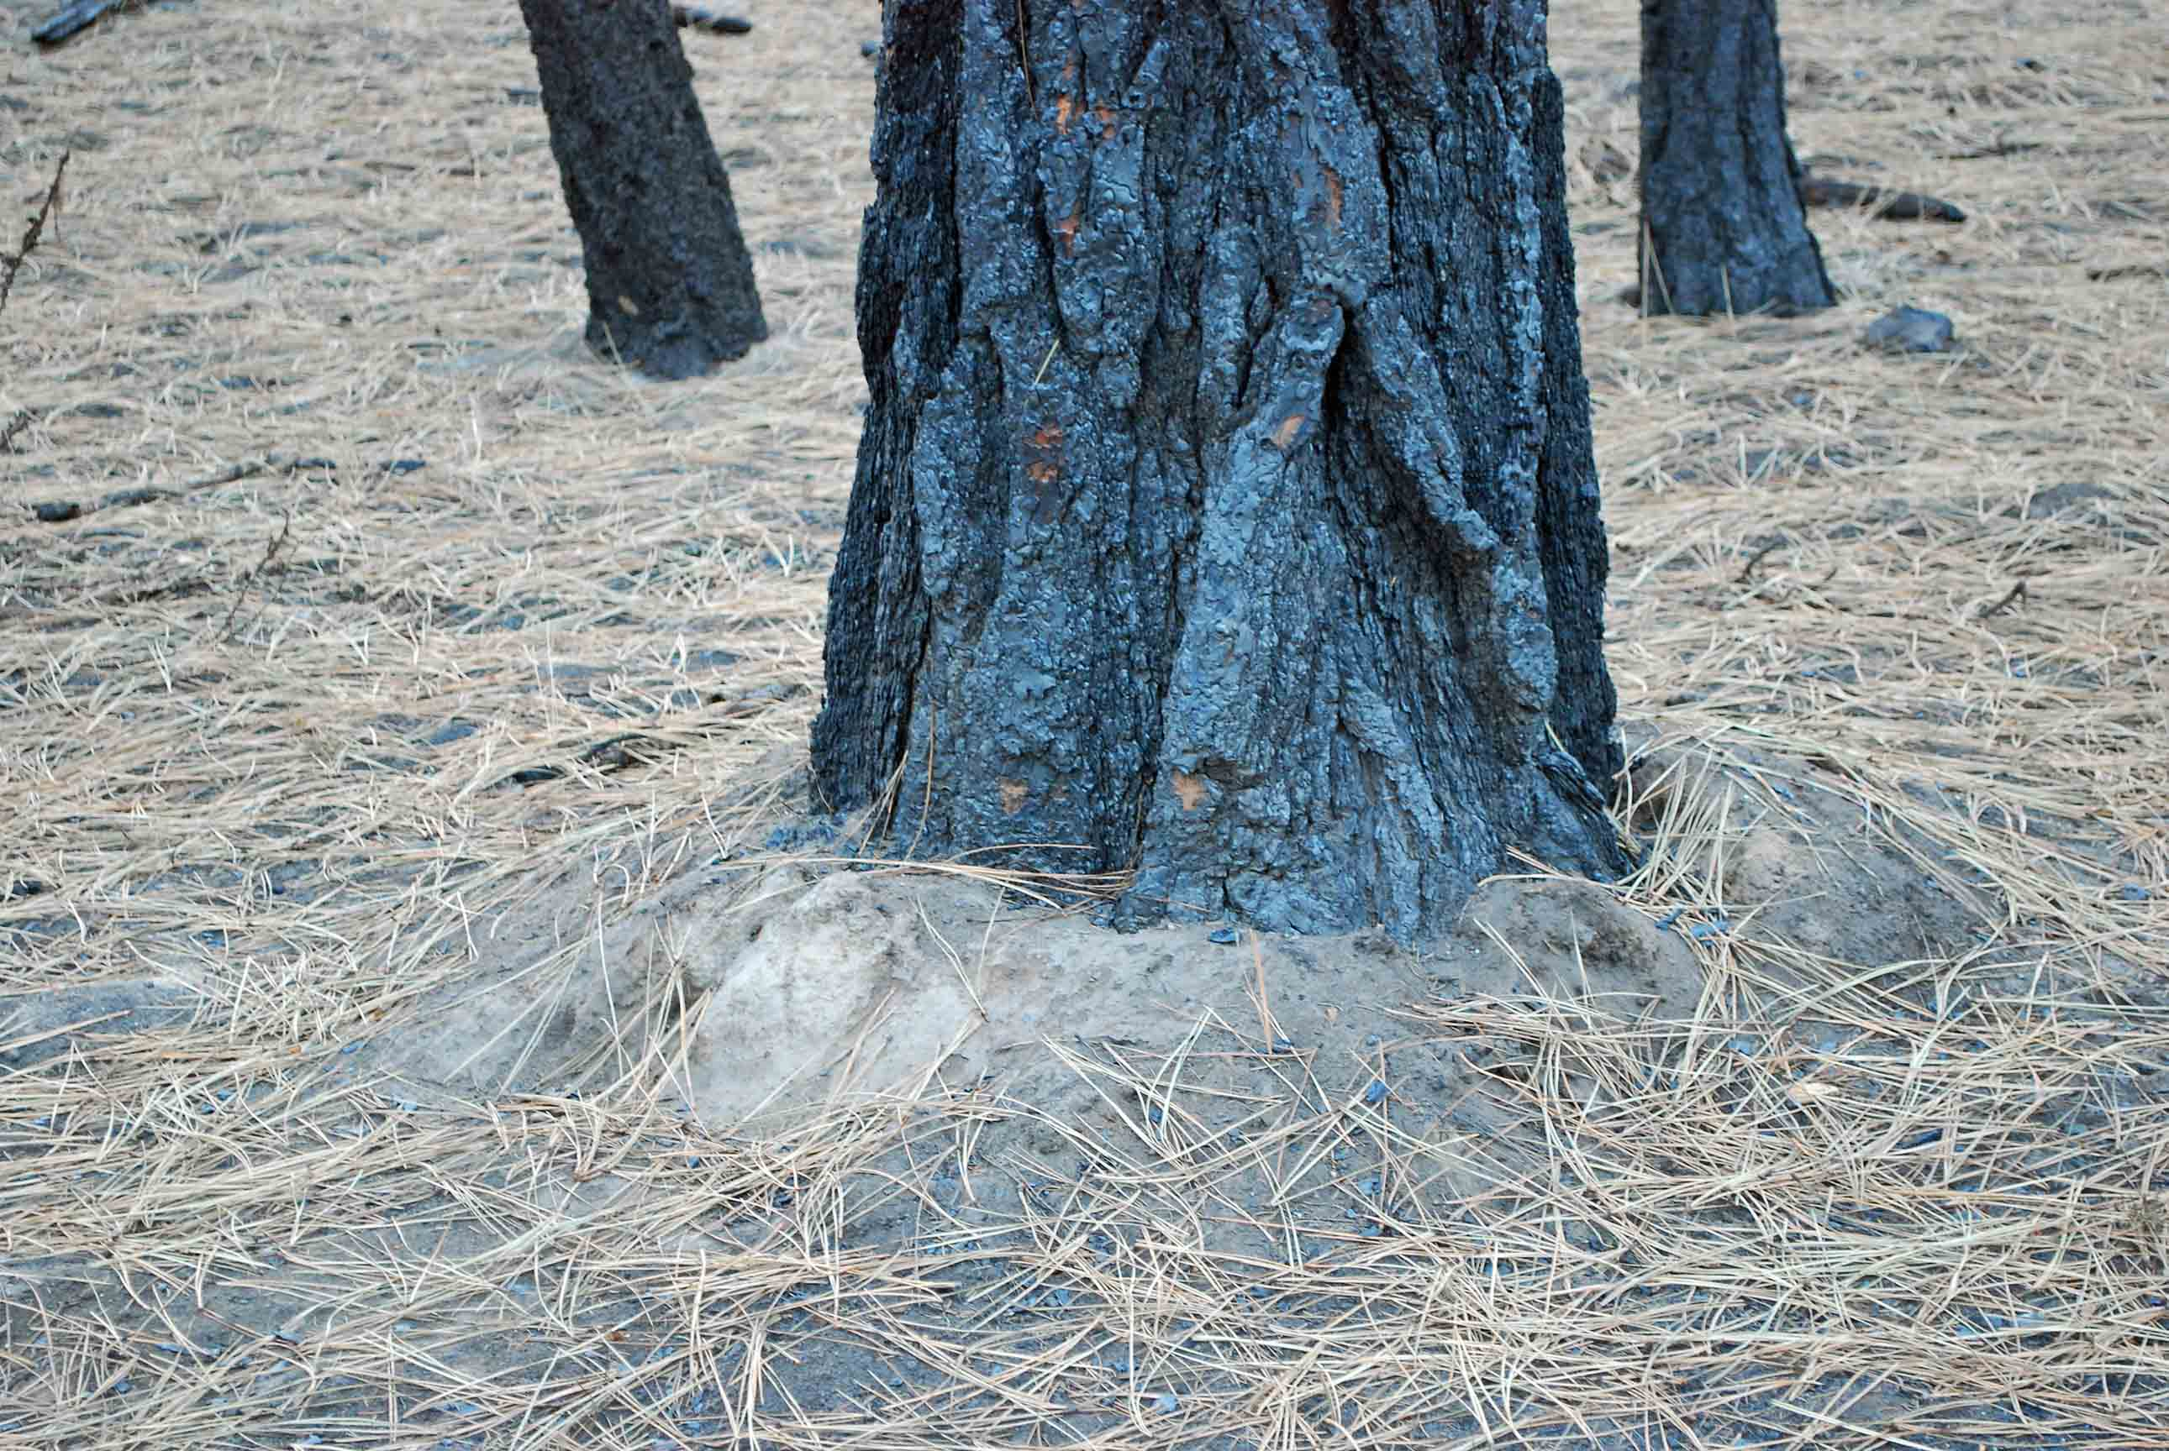

Slide 29
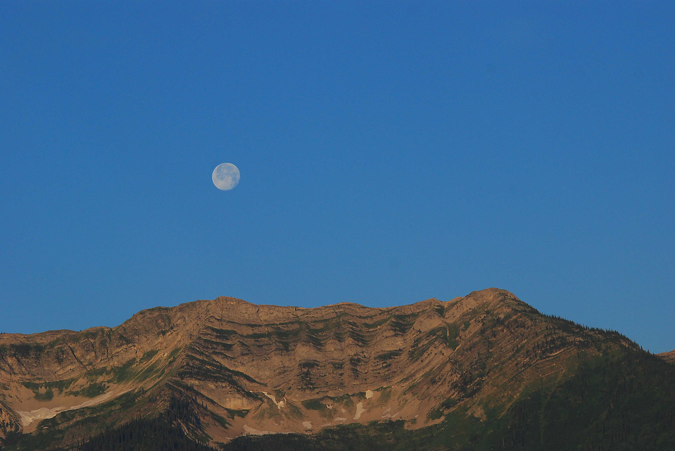

Slide 30
Proposed approach, bark beetles – draft ground survey form
Tree # | Spp | DBH | Beetle attack code | Crown scorch % | Bark Char | Bark Char % circumference
Plot _____Type _____ GPS #____Crew:___Date: ______
Elevation ____Aspect___Slope (U/D%) _______
Surrounding area similar to plot:
< ½ ha ½-2 ha 2-5 ha >5 ha
Ground char 0 1 2 3
Vegetation burn severity 0 1 2 3 4

Slide 31
Proposed approach, bark beetles – draft ground survey form
Vegetation burn severity class
0 unburned | Green unburned
1 Low | Canopy unburned, trunks partially burned, understory lightly or patchily burned. Green
2 Moderate | Trees burned and dead, scorched needles remain on canopy trees, understory burned and blackened. Red/brown
3 High | Canopy trees blackened (charred) and dead, needles consumed, understory burned. Black

Slide 32
Proposed approach, bark beetles – draft ground survey form
Bark char code and Bark appearance
0. Unburned | No char
1. Light | Evidence of light scorching; can still identify species based on bark characteristics; bark is not completely blackened; edges of bark plates charred
2. Moderate | Bark is uniformly black except possibly some inner fissures; species bark characteristics still discernable
3. Deep | Bark is uniformly black, some species bark characteristics still discernable
4. Very deep | Bark has been burned into, but not necessarily to the wood; outer bark species characteristics are lost.

Slide 33
Proposed approach, bark beetles – draft ground survey form
Ground char class
0. Unburned | The fire did not burn on the forest floor.
1.Light ground char | Leaf litter is charred or consumed. Some small twigs and much of the branch wood remain.
2.Moderate ground char | Duff is deeply charred or consumed. No foliage or twigs remain. Logs are deeply charred. Burned-out stump holes occur.
3.Deep ground char | Litter and duff are completely consumed, top layer of mineral soil is visibly altered, often reddish. Sound logs are deeply charred.

